Slide 1
Tutorial 1.2
https://colab.research.google.com/drive/178YLXiIyqTL4paBdqTk5vEHk-w3jDlah#scrollTo=8jNnKnjxbWk-
Eco modeling statistics

Slide 2
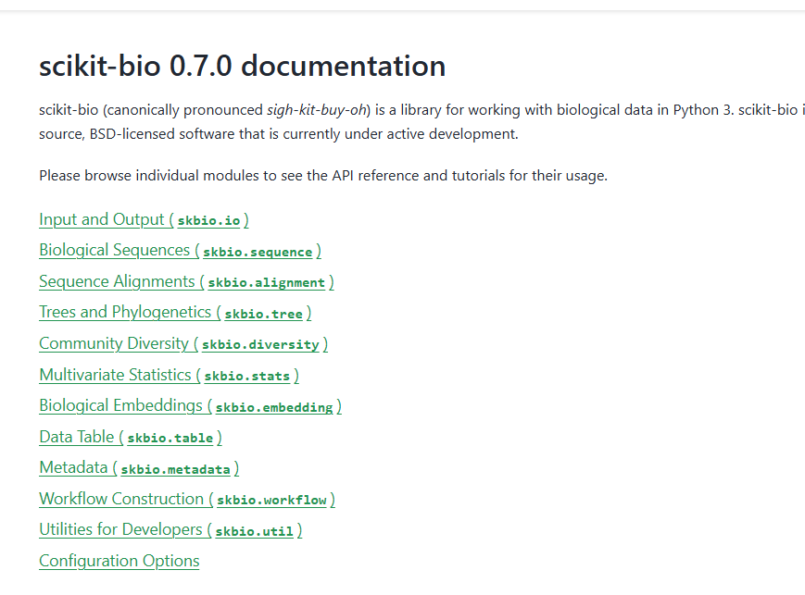
Statistical tools
https://scikit.bio/index.html

Slide 3
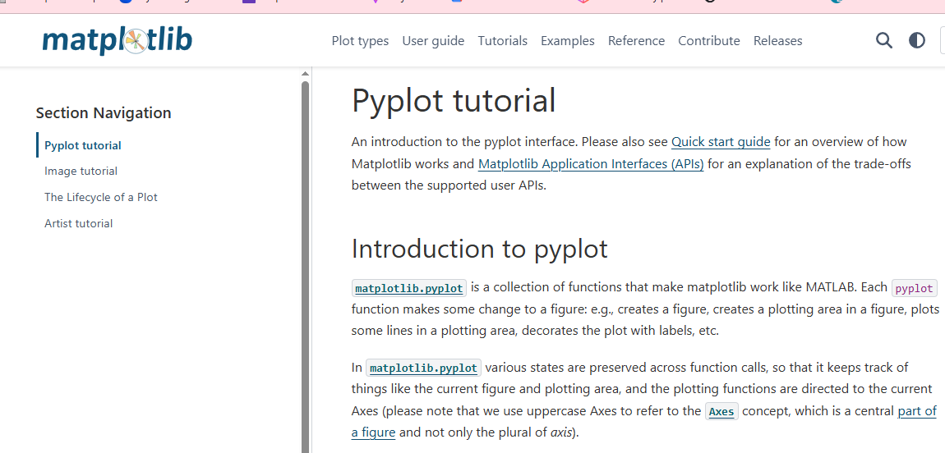
Statistical tools
https://scikit.bio/index.html

Slide 4
Cell 1 - import libraries
# Cell 1: Import Libraries
"""
Python Statistical Tools - Basic Tutorial
Essential libraries for data analysis and visualization
"""
import matplotlib.pyplot as plt
import seaborn as sns
import pandas as pd
import numpy as np
from sklearn.model_selection import train_test_split
from sklearn.linear_model import LinearRegression
from sklearn.metrics import mean_squared_error, r2_score
from sklearn.preprocessing import StandardScaler
from sklearn.cluster import KMeans
from scipy import stats
print("All libraries imported successfully!")

Slide 5
# Cell 2: Matplotlib - Basic Data Creation
"""
MATPLOTLIB BASICS - Creating Sample Data
"""
# Create sample data for demonstration
np.random.seed(42) # For reproducible results
x = np.linspace(0, 10, 100)
y = 2 * x + 1 + np.random.normal(0, 1, 100)
print("Sample data created:")
print(f"X range: {x.min():.2f} to {x.max():.2f}")
print(f"Y range: {y.min():.2f} to {y.max():.2f}")
Sample data created:
X range: 0.00 to 10.00
Y range: 1.06 to 20.86

Slide 6
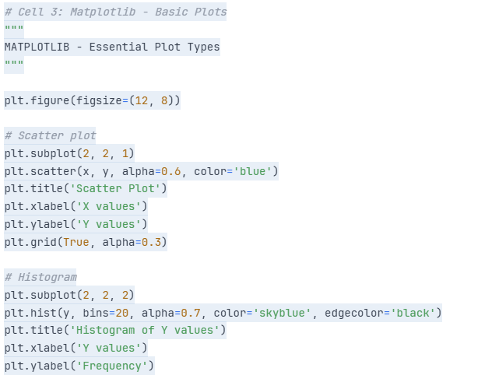
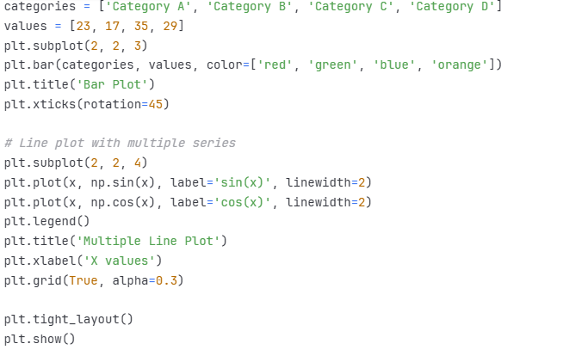

Slide 7
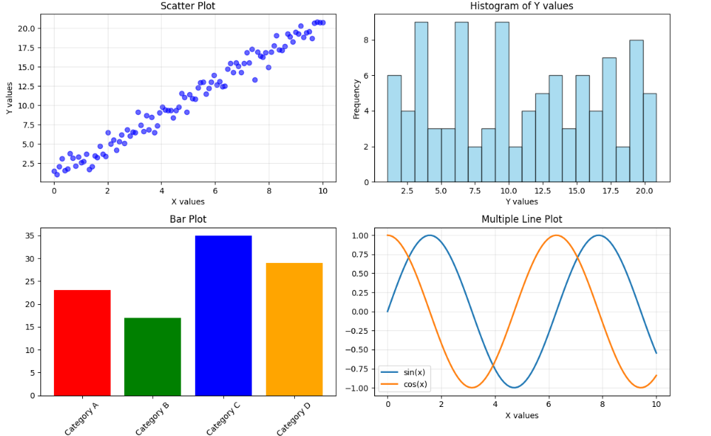

Slide 8
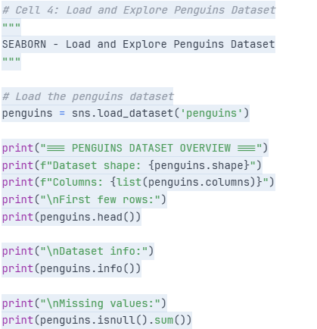
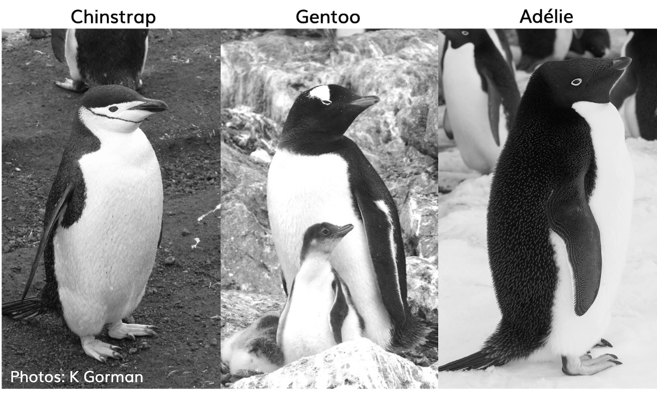
The penguins dataset is a sample dataset included in the seaborn library. It contains measurements and observations of penguins from the Palmer Archipelago, Antarctica. The data was collected and made available by Dr. Kristen Gorman and the Palmer Station, Antarctica LTER. It's commonly used for data exploration and visualization examples.
https://education.rstudio.com/blog/2020/07/palmerpenguins-cran/

Slide 9
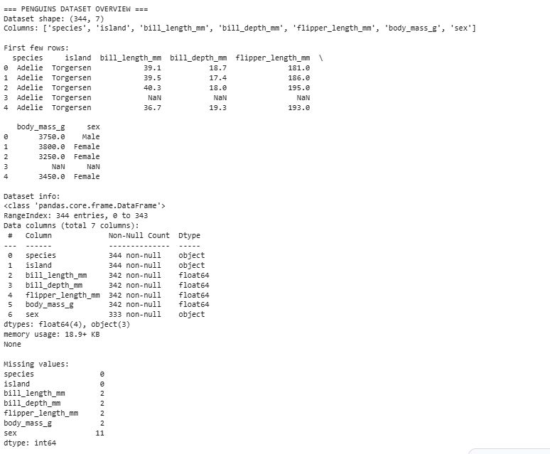

Slide 10
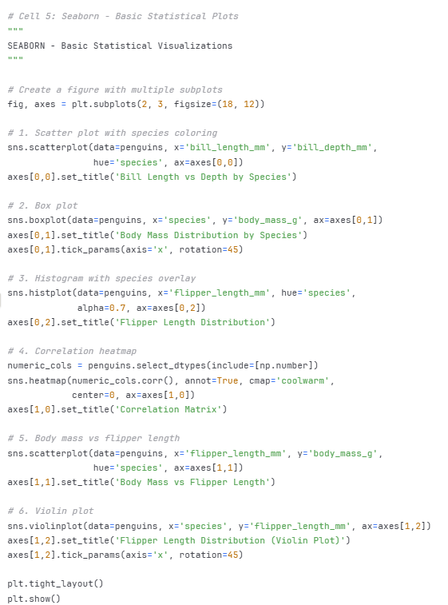
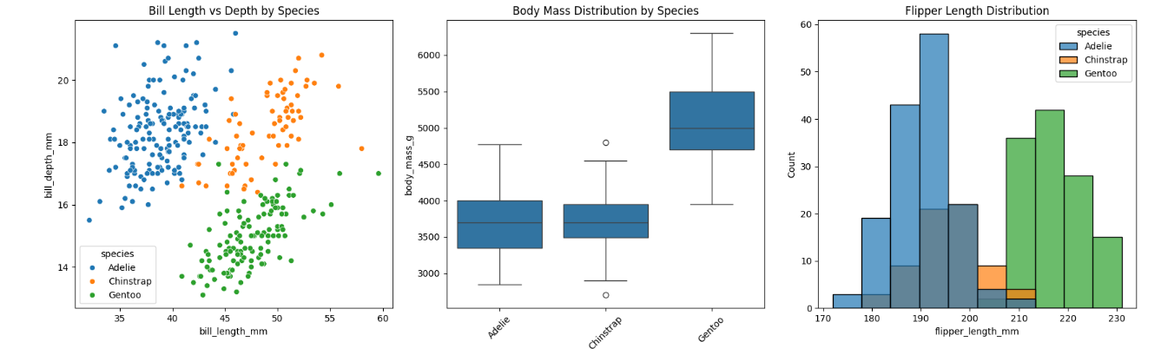
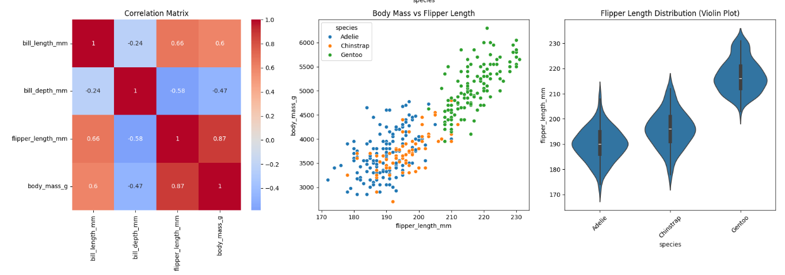

Slide 11
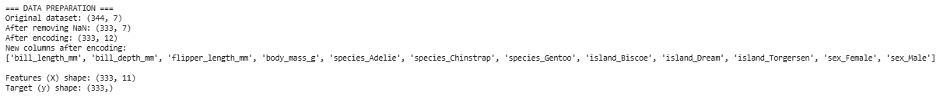
# Cell 6: Data Preparation for Machine Learning
"""
SCIKIT-LEARN - Data Preparation
"""
print("=== DATA PREPARATION ===")
# Remove rows with missing values
penguins_clean = penguins.dropna()
print(f"Original dataset: {penguins.shape}")
print(f"After removing NaN: {penguins_clean.shape}")
# Convert categorical variables to numeric (one-hot encoding)
penguins_encoded = pd.get_dummies(penguins_clean,
columns=['species', 'island', 'sex'])
print(f"After encoding: {penguins_encoded.shape}")
print("New columns after encoding:")
print(list(penguins_encoded.columns))
# Separate features and target variable
X = penguins_encoded.drop('body_mass_g', axis=1) # Features
y = penguins_encoded['body_mass_g'] # Target
print(f"\nFeatures (X) shape: {X.shape}")
print(f"Target (y) shape: {y.shape}")
Handle Missing Values: The code first removes any rows with missing values using penguins.dropna() and stores the result in penguins_clean. It then prints the shape of the original and cleaned dataframes to show how many rows were removed.
One-Hot Encoding: Machine learning models typically require numerical input. The pd.get_dummies() function is used to convert categorical columns ('species', 'island', and 'sex') into a numerical format using one-hot encoding. This creates new binary columns for each unique category within those columns. The resulting dataframe is stored in penguins_encoded, and its shape and new column names are printed.
Separate Features and Target: The code then separates the dataset into features (independent variables) and the target variable (dependent variable). The body_mass_g column is selected as the target variable y, and all other columns are considered features X. The shapes of X and y are printed to confirm the separation.
This cell effectively transforms the raw penguins data into a format suitable for training a machine learning model.

Slide 12
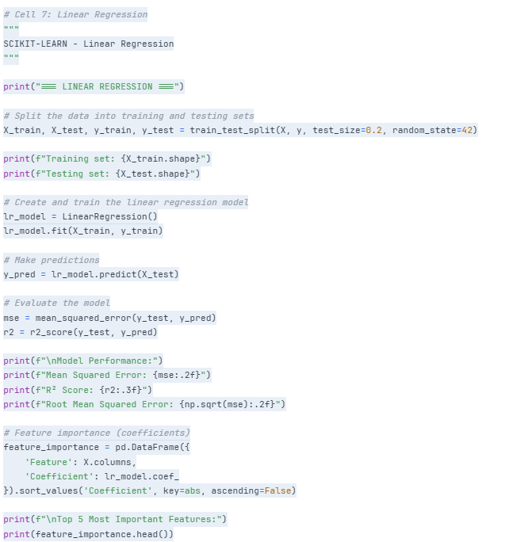
The variables X_test and y_train (along with X_train and y_test) were created in the "Linear Regression" cell using the train_test_split function from the scikit-learn library.
The train_test_split function is a standard tool in machine learning for dividing your dataset into two subsets:
Training Set (X_train, y_train): This subset is used to train the machine learning model. The model learns the relationships between the features (X_train) and the target variable (y_train) from this data.
Testing Set (X_test, y_test): This subset is used to evaluate the performance of the trained model on data it has not seen before. The model makes predictions on X_test, and these predictions are compared to the actual values in y_test to assess how well the model generalizes.
In this specific case, test_size=0.2 means that 20% of the data was allocated to the testing set, and the remaining 80% was used for the training set. The random_state=42 ensures that the split is the same every time the code is run, making the results reproducible.
So, X_test contains the features for the testing data, and y_train contains the target variable (body mass) for the training data.

Slide 13
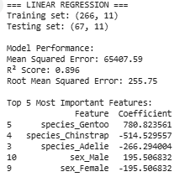
Linear regression results
Training set: (266, 11) and Testing set: (67, 11): This shows the size of the datasets used for training and testing the model. The training set has 266 samples (rows) and 11 features (columns), while the testing set has 67 samples and the same 11 features. The data was split so the model could learn from one portion (training) and be evaluated on unseen data (testing).
Model Performance:: This section provides metrics to evaluate how well the linear regression model performed in predicting penguin body mass.
Mean Squared Error: 65407.59: This is the average of the squared differences between the actual body mass values and the predicted body mass values. A lower MSE indicates a better fit. The value 65407.59 means that, on average, the squared error of the predictions is quite large, but the context of the target variable's range (body mass in grams) is important here.
R² Score: 0.896: The R-squared score, also known as the coefficient of determination, represents the proportion of the variance in the target variable (body mass) that is predictable from the features. An R-squared of 0.896 (or 89.6%) is quite high, indicating that about 89.6% of the variation in penguin body mass can be explained by the features included in the model. This suggests the model is a good fit for the data.
Root Mean Squared Error: 255.75: This is the square root of the Mean Squared Error. It is in the same units as the target variable (grams). An RMSE of 255.75 means that, on average, the model's predictions are off by about 255.75 grams. This gives a more intuitive sense of the typical error size than the MSE.
Top 5 Most Important Features:: This table shows the features that have the largest absolute coefficients in the linear regression model, indicating their relative influence on the predicted body mass.
The Coefficient column shows the change in predicted body mass for a one-unit increase in the feature, holding all other features constant.
species_Gentoo, species_Chinstrap, and species_Adelie have the largest coefficients by far. This suggests that the species of the penguin is a very strong predictor of its body mass. Gentoo penguins have the largest positive coefficient, indicating they tend to have significantly higher body mass compared to the baseline (or the other species when using one-hot encoding in this way). Chinstrap and Adelie penguins have negative coefficients, indicating they tend to have lower body mass compared to Gentoo penguins.
sex_Male and sex_Female also have relatively large coefficients, suggesting that sex is another important factor influencing body mass, with males generally having higher body mass than females.
In summary, the linear regression model performed well in predicting penguin body mass, with species being the most influential factor, followed by sex.

Slide 14
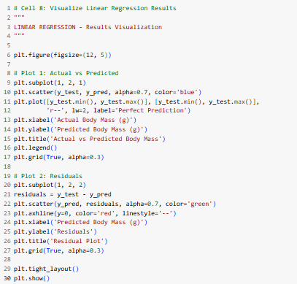
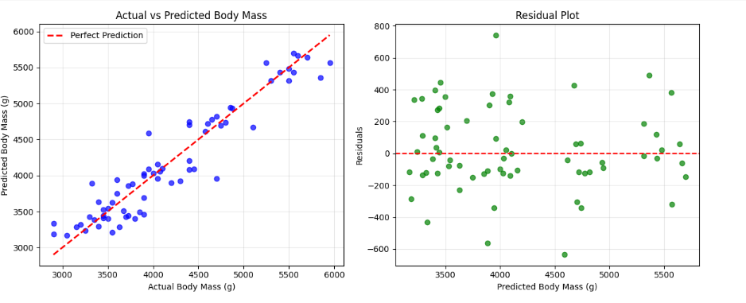
Linear regression visualiation

Slide 15
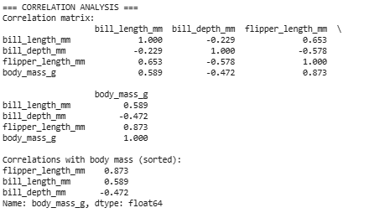
Basic correlation
# Cell 9: Basic Statistical Analysis
"""
BASIC STATISTICAL ANALYSIS
"""
print("=== CORRELATION ANALYSIS ===")
# Calculate correlations
numeric_cols = ['bill_length_mm', 'bill_depth_mm', 'flipper_length_mm', 'body_mass_g']
correlations = penguins_clean[numeric_cols].corr()
print("Correlation matrix:")
print(correlations.round(3))
print("\nCorrelations with body mass (sorted):")
body_mass_corr = correlations['body_mass_g'].drop('body_mass_g').sort_values(ascending=False)
print(body_mass_corr.round(3))

Slide 16
Basic correlation
Correlation matrix:: This is a table that displays the pairwise correlation coefficients between each pair of numerical variables.
A correlation coefficient is a value between -1 and +1 that indicates the strength and direction of the linear relationship between two variables.
A value close to +1 indicates a strong positive linear relationship (as one variable increases, the other tends to increase).
A value close to -1 indicates a strong negative linear relationship (as one variable increases, the other tends to decrease).
A value close to 0 indicates a weak or no linear relationship.
The diagonal of the matrix is always 1.000 because a variable is perfectly correlated with itself.
For example, the correlation between bill_length_mm and bill_depth_mm is -0.229, suggesting a weak negative linear relationship. The correlation between flipper_length_mm and body_mass_g is 0.873, indicating a strong positive linear relationship.
Correlations with body mass (sorted):: This section specifically shows the correlation coefficients between each of the other numerical features and body_mass_g, sorted from the strongest positive correlation to the strongest negative correlation.
flipper_length_mm 0.873: This confirms that flipper length has a strong positive correlation with body mass. This means that penguins with longer flippers tend to have higher body mass.
bill_length_mm 0.589: Bill length has a moderate positive correlation with body mass.
bill_depth_mm -0.472: Bill depth has a moderate negative correlation with body mass. This means that penguins with deeper bills tend to have lower body mass (or vice versa).
This analysis helps understand which numerical features are most strongly related to penguin body mass. The strong positive correlation between flipper_length_mm and body_mass_g is particularly notable and aligns with the findings from the linear regression feature importance, where flipper length also had a significant coefficient.

Slide 17
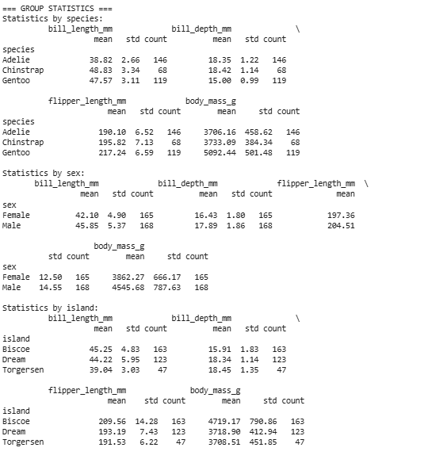
Cell 10:GROUP STATISTICS AND SETUP FOR HYPOTHESIS TESTING
print("=== GROUP STATISTICS ===")
# Calculate statistics by species
species_stats = penguins_clean.groupby('species')[numeric_cols].agg(['mean', 'std', 'count'])
print("Statistics by species:")
print(species_stats.round(2))
# Calculate statistics by sex
print("\nStatistics by sex:")
sex_stats = penguins_clean.groupby('sex')[numeric_cols].agg(['mean', 'std', 'count'])
print(sex_stats.round(2))
# Calculate statistics by island
print("\nStatistics by island:")
island_stats = penguins_clean.groupby('island')[numeric_cols].agg(['mean', 'std', 'count'])
print(island_stats.round(2))
print("\n" + "="*50)
print("HYPOTHESIS TESTING SECTION")
print("="*50)
print("We'll now perform various statistical tests using the penguins dataset")
print("to answer different research questions.")

Slide 18
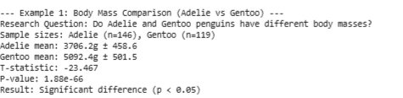
Cell 11:T TESTS
print("=== T-TEST EXAMPLES ===")
print("T-tests compare means between two groups for continuous variables")
# Example 1: Compare body mass between Adelie and Gentoo penguins
print("\n--- Example 1: Body Mass Comparison (Adelie vs Gentoo) ---")
adelie_mass = penguins_clean[penguins_clean['species'] == 'Adelie']['body_mass_g'].dropna()
gentoo_mass = penguins_clean[penguins_clean['species'] == 'Gentoo']['body_mass_g'].dropna()
t_stat1, p_value1 = stats.ttest_ind(adelie_mass, gentoo_mass)
print(f"Research Question: Do Adelie and Gentoo penguins have different body masses?")
print(f"Sample sizes: Adelie (n={len(adelie_mass)}), Gentoo (n={len(gentoo_mass)})")
print(f"Adelie mean: {adelie_mass.mean():.1f}g ± {adelie_mass.std():.1f}")
print(f"Gentoo mean: {gentoo_mass.mean():.1f}g ± {gentoo_mass.std():.1f}")
print(f"T-statistic: {t_stat1:.3f}")
print(f"P-value: {p_value1:.2e}")
print(f"Result: {'Significant difference (p < 0.05)' if p_value1 < 0.05 else 'No significant difference (p ≥ 0.05)'}")
Example 1: Body Mass Comparison (Adelie vs Gentoo)
Research Question: The goal was to see if there's a statistically significant difference in the average body mass between Adelie and Gentoo penguins.
Sample sizes: This tells you how many penguins were included in each group for this specific test (146 Adelie and 119 Gentoo).
Adelie mean: 3706.2g ± 458.6 and Gentoo mean: 5092.4g ± 501.5: These are the calculated average body masses for each group, along with their standard deviations (which indicate the spread of the data around the mean). You can see that the sample means are quite different.
T-statistic: -23.467: This is the calculated t-statistic. It measures the difference between the two group means relative to the variability within the groups. A larger absolute value of the t-statistic suggests a greater difference between the group means.
P-value: 1.88e-66: This is the p-value. It represents the probability of observing a t-statistic as extreme as, or more extreme than, the one calculated, assuming that the null hypothesis (that there is no difference between the group means) is true. A very small p-value (like 1.88e-66, which is a number with 65 zeros after the decimal point before the 188) indicates that it is highly unlikely to observe such a difference in means by random chance if there were no true difference in the populations.
Result: Significant difference (p < 0.05): This is the conclusion based on the p-value. Since the p-value (1.88e-66) is much smaller than the common significance level of 0.05, we reject the null hypothesis and conclude that there is a statistically significant difference in body mass between Adelie and Gentoo penguins.

Slide 19
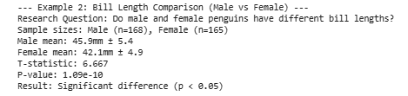
Cell 11:T TESTS
# Example 2: Compare bill length between male and female penguins
print("\n--- Example 2: Bill Length Comparison (Male vs Female) ---")
male_bill = penguins_clean[penguins_clean['sex'] == 'Male']['bill_length_mm'].dropna()
female_bill = penguins_clean[penguins_clean['sex'] == 'Female']['bill_length_mm'].dropna()
t_stat2, p_value2 = stats.ttest_ind(male_bill, female_bill)
print(f"Research Question: Do male and female penguins have different bill lengths?")
print(f"Sample sizes: Male (n={len(male_bill)}), Female (n={len(female_bill)})")
print(f"Male mean: {male_bill.mean():.1f}mm ± {male_bill.std():.1f}")
print(f"Female mean: {female_bill.mean():.1f}mm ± {female_bill.std():.1f}")
print(f"T-statistic: {t_stat2:.3f}")
print(f"P-value: {p_value2:.2e}")
print(f"Result: {'Significant difference (p < 0.05)' if p_value2 < 0.05 else 'No significant difference (p ≥ 0.05)'}")
Example 2: Bill Length Comparison (Male vs Female)
Research Question: The question here was whether male and female penguins have different average bill lengths.
Sample sizes: 168 male and 165 female penguins were included.
Male mean: 45.9mm ± 5.4 and Female mean: 42.1mm ± 4.9: These are the average bill lengths for male and female penguins, showing that male penguins in this sample have a slightly larger average bill length.
T-statistic: 6.667: The calculated t-statistic for this comparison.
P-value: 1.09e-10: Another very small p-value, indicating that the observed difference in bill lengths between male and female penguins is highly unlikely to be due to random chance.
Result: Significant difference (p < 0.05): Based on the small p-value, we conclude that there is a statistically significant difference in bill length between male and female penguins.

Slide 20
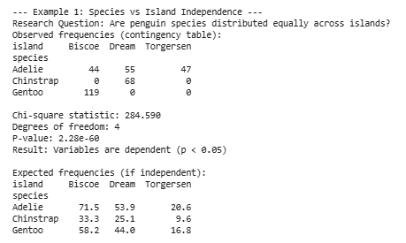
Cell 12: Chi-Square Tests - Chi-square tests examine independence between categorical variables
# Example 1: Test independence between species and island
print("\n--- Example 1: Species vs Island Independence ---")
crosstab1 = pd.crosstab(penguins_clean['species'], penguins_clean['island'])
chi2_1, p_chi1, dof1, expected1 = stats.chi2_contingency(crosstab1)
print(f"Research Question: Are penguin species distributed equally across islands?")
print("Observed frequencies (contingency table):")
print(crosstab1)
print(f"\nChi-square statistic: {chi2_1:.3f}")
print(f"Degrees of freedom: {dof1}")
print(f"P-value: {p_chi1:.2e}")
print(f"Result: {'Variables are dependent (p < 0.05)' if p_chi1 < 0.05 else 'Variables are independent (p ≥ 0.05)'}")
print("\nExpected frequencies (if independent):")
expected_df = pd.DataFrame(expected1,
index=crosstab1.index,
columns=crosstab1.columns)
print(expected_df.round(1))
pd.crosstab() is a function in the pandas library that is used to compute a frequency table of two or more factors. Essentially, it helps you create a contingency table, which is a table that displays the multivariate frequency distribution of the variables.

Slide 21
Cell 12: Chi-Square Tests - Chi-square tests examine independence between categorical variables
--- Example 1: Species vs Island Independence ---: This is a header for this specific test.
Research Question: Are penguin species distributed equally across islands?: This clearly states the hypothesis being tested. The null hypothesis is that there is no association between species and island (they are independent), and the alternative hypothesis is that there is an association (they are dependent).
Observed frequencies (contingency table):: This table shows the actual counts of penguins for each combination of species and island in your dataset. For example, you observed 44 Adelie penguins on Biscoe island, 68 Chinstrap penguins on Dream island, and 119 Gentoo penguins on Biscoe island.
Chi-square statistic: 284.590: This is the calculated Chi-Square test statistic. It measures the difference between the observed frequencies and the expected frequencies (what you would expect if species and island were truly independent). A larger Chi-Square value indicates a greater discrepancy between observed and expected frequencies, suggesting a stronger association.
Degrees of freedom: 4: This value is determined by the number of rows and columns in your contingency table ( (number of rows - 1) * (number of columns - 1) = (3 - 1) * (3 - 1) = 2 * 2 = 4). The degrees of freedom are used to determine the critical value from the Chi-Square distribution.
P-value: 2.28e-60: This is the p-value associated with the calculated Chi-Square statistic and degrees of freedom. It's an extremely small number (essentially zero for practical purposes). A very small p-value means that it is highly improbable to observe the distribution of penguins across islands that you did if species and island were truly independent.
Result: Variables are dependent (p < 0.05): This is the conclusion. Since the p-value (2.28e-60) is much less than the standard significance level of 0.05, we reject the null hypothesis of independence. We conclude that there is a statistically significant dependence or association between penguin species and the island they are found on.
Expected frequencies (if independent):: This table shows the expected counts for each cell in the contingency table if there were no association between species and island. These values are calculated based on the row and column totals. Comparing the "Observed frequencies" table to the "Expected frequencies" table visually helps you see where the biggest differences lie and understand the nature of the dependence. For example, you observed 44 Adelie penguins on Biscoe, but you would expect about 71.5 if there was no association. You observed 0 Chinstrap penguins on Biscoe, but you would expect about 33.3 if there was no association. This clearly shows that Chinstrap and Gentoo penguins are not found on all islands, while Adelie penguins are.

Slide 22
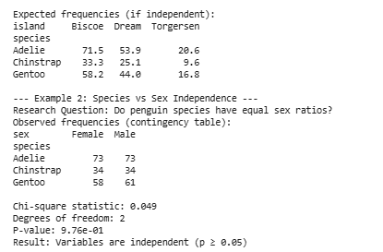
Cell 12: Chi-Square Tests - Chi-square tests examine independence between categorical variables
# Example 2: Test independence between species and sex
print("\n--- Example 2: Species vs Sex Independence ---")
crosstab2 = pd.crosstab(penguins_clean['species'], penguins_clean['sex'])
chi2_2, p_chi2, dof2, expected2 = stats.chi2_contingency(crosstab2)
print(f"Research Question: Do penguin species have equal sex ratios?")
print("Observed frequencies (contingency table):")
print(crosstab2)
print(f"\nChi-square statistic: {chi2_2:.3f}")
print(f"Degrees of freedom: {dof2}")
print(f"P-value: {p_chi2:.2e}")
print(f"Result: {'Variables are dependent (p < 0.05)' if p_chi2 < 0.05 else 'Variables are independent (p ≥ 0.05)'}")

Slide 23
Cell 12: Chi-Square Tests - Chi-square tests examine independence between categorical variables
Research Question: Do penguin species have equal sex ratios?: This is the hypothesis being tested. The null hypothesis is that the proportion of males and females is the same across all three penguin species (i.e., species and sex are independent). The alternative hypothesis is that the sex ratios differ between species (i.e., species and sex are dependent).
Observed frequencies (contingency table):: This table shows the actual counts of male and female penguins for each species in your dataset. For example, you observed 73 female and 73 male Adelie penguins, 34 female and 34 male Chinstrap penguins, and 58 female and 61 male Gentoo penguins.
Chi-square statistic: 0.049: This is the calculated Chi-Square test statistic for this test. Compared to the previous Chi-Square statistic (284.590), this value is very small, suggesting that the observed frequencies are very close to what would be expected if species and sex were independent.
Degrees of freedom: 2: This is calculated as (number of rows - 1) * (number of columns - 1) = (3 - 1) * (2 - 1) = 2 * 1 = 2.
P-value: 9.76e-01: This is the p-value, which is approximately 0.976. This is a very large p-value (much larger than the common significance level of 0.05). A large p-value means that there is a high probability (about 97.6%) of observing a distribution of sex within species as you did, assuming that sex ratios are truly the same across all species.
Result: Variables are independent (p ≥ 0.05): This is the conclusion. Since the p-value (0.976) is much greater than 0.05, we fail to reject the null hypothesis. We conclude that there is no statistically significant evidence to suggest that the sex ratios differ between penguin species. In other words, based on this data, the distribution of males and females appears to be independent of the penguin species.
In summary, while the previous Chi-Square test showed a strong association between species and island, this test suggests that within this dataset, the sex distribution is not significantly different across the three penguin species.

Slide 24
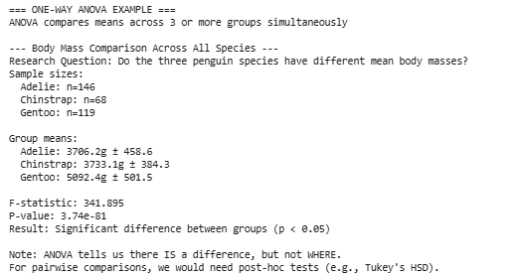
# Cell 13: ONE-WAY ANOVA Test
# Compare body mass across all three species
print("\n--- Body Mass Comparison Across All Species ---")
adelie_mass_anova = penguins_clean[penguins_clean['species'] == 'Adelie']['body_mass_g'].dropna()
chinstrap_mass_anova = penguins_clean[penguins_clean['species'] == 'Chinstrap']['body_mass_g'].dropna()
gentoo_mass_anova = penguins_clean[penguins_clean['species'] == 'Gentoo']['body_mass_g'].dropna()
f_stat, p_anova = stats.f_oneway(adelie_mass_anova, chinstrap_mass_anova, gentoo_mass_anova)
print(f"Research Question: Do the three penguin species have different mean body masses?")
print(f"Sample sizes:")
print(f" Adelie: n={len(adelie_mass_anova)}")
print(f" Chinstrap: n={len(chinstrap_mass_anova)}")
print(f" Gentoo: n={len(gentoo_mass_anova)}")
print(f"\nGroup means:")
print(f" Adelie: {adelie_mass_anova.mean():.1f}g ± {adelie_mass_anova.std():.1f}")
print(f" Chinstrap: {chinstrap_mass_anova.mean():.1f}g ± {chinstrap_mass_anova.std():.1f}")
print(f" Gentoo: {gentoo_mass_anova.mean():.1f}g ± {gentoo_mass_anova.std():.1f}")
print(f"\nF-statistic: {f_stat:.3f}")
print(f"P-value: {p_anova:.2e}")
print(f"Result: {'Significant difference between groups (p < 0.05)' if p_anova < 0.05 else 'No significant difference (p ≥ 0.05)'}")
if p_anova < 0.05:
print("\nNote: ANOVA tells us there IS a difference, but not WHERE.")
print("For pairwise comparisons, we would need post-hoc tests (e.g., Tukey's HSD).")

Slide 25
# Cell 13: ONE-WAY ANOVA Test
Research Question: Do the three penguin species have different mean body masses?: This is the hypothesis being tested. The null hypothesis is that the mean body mass is the same for all three species. The alternative hypothesis is that at least one species has a different mean body mass.
Sample sizes:: This shows the number of penguins included in the analysis for each species.
Group means:: This displays the calculated average body mass and standard deviation for each species. You can see that the mean body mass for Gentoo penguins (5092.4g) appears considerably higher than for Adelie (3706.2g) and Chinstrap (3733.1g) penguins.
F-statistic: 341.895: This is the calculated F-statistic. In ANOVA, the F-statistic is the ratio of the variance between the groups to the variance within the groups. A larger F-statistic suggests that the differences between the group means are large relative to the variability within each group. A value of 341.895 is quite large.
P-value: 3.74e-81: This is the p-value associated with the F-statistic. Like in the t-tests, a very small p-value (3.74e-81 is a number with 80 zeros after the decimal point before 374) indicates that it is extremely unlikely to observe such a large F-statistic by random chance if the mean body masses of the three species were actually equal.
Result: Significant difference between groups (p < 0.05): This is the conclusion. Since the p-value is much smaller than the standard significance level of 0.05, we reject the null hypothesis. We conclude that there is a statistically significant difference in the mean body mass among the three penguin species.
Note: ANOVA tells us there IS a difference, but not WHERE.: This is an important point. The ANOVA test tells you that at least one group mean is different from the others, but it doesn't tell you which specific groups are different from each other (e.g., is Adelie different from Chinstrap, is Adelie different from Gentoo, is Chinstrap different from Gentoo?).
For pairwise comparisons, we would need post-hoc tests (e.g., Tukey's HSD).: This explains that to determine which specific pairs of groups have significant differences, you would need to perform additional tests called post-hoc tests (like Tukey's Honestly Significant Difference test).
In summary, the ANOVA test provides strong statistical evidence that the average body mass is not the same across all three penguin species. The visual inspection of the means also supports this, with Gentoo penguins appearing to be significantly heavier.

Slide 26
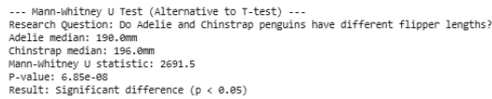
# Cell 14: Non-parametric Tests NON-PARAMETRIC TESTS: When Data Doesn't Meet Normal Distribution Assumption
print("=== NON-PARAMETRIC TEST EXAMPLES ===")
print("Use these when data is not normally distributed or has unequal variances")
# Mann-Whitney U test (non-parametric alternative to t-test)
print("\n--- Mann-Whitney U Test (Alternative to T-test) ---")
# Compare flipper length between Adelie and Chinstrap
adelie_flipper = penguins_clean[penguins_clean['species'] == 'Adelie']['flipper_length_mm'].dropna()
chinstrap_flipper = penguins_clean[penguins_clean['species'] == 'Chinstrap']['flipper_length_mm'].dropna()
mannwhitney_stat, mannwhitney_p = stats.mannwhitneyu(adelie_flipper, chinstrap_flipper,
alternative='two-sided')
print(f"Research Question: Do Adelie and Chinstrap penguins have different flipper lengths?")
print(f"Adelie median: {adelie_flipper.median():.1f}mm")
print(f"Chinstrap median: {chinstrap_flipper.median():.1f}mm")
print(f"Mann-Whitney U statistic: {mannwhitney_stat}")
print(f"P-value: {mannwhitney_p:.2e}")
print(f"Result: {'Significant difference (p < 0.05)' if mannwhitney_p < 0.05 else 'No significant difference (p ≥ 0.05)'}")
Mann-Whitney U Test (Alternative to T-test)
What it does: This test is used to compare the distributions of a continuous variable between two independent groups. It's the non-parametric equivalent of the independent samples t-test. It tests if the distributions of the two groups are the same.
Research Question: Do Adelie and Chinstrap penguins have different flipper lengths?
Adelie median: 190.0mm and Chinstrap median: 196.0mm: Medians are often used as a measure of central tendency in non-parametric tests because they are less affected by outliers than means. The medians suggest a difference in flipper lengths between the two species.
Mann-Whitney U statistic: 2691.5: This is the calculated test statistic for the Mann-Whitney U test.
P-value: 6.85e-08: This very small p-value indicates that it's highly unlikely to observe the observed difference in flipper lengths between Adelie and Chinstrap penguins if their flipper length distributions were actually the same.
Result: Significant difference (p < 0.05): Since the p-value is less than 0.05, we reject the null hypothesis that the distributions are the same. We conclude that there is a statistically significant difference in flipper lengths between Adelie and Chinstrap penguins.

Slide 27
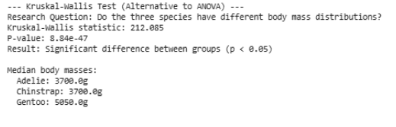
# Cell 14: Non-parametric Tests NON-PARAMETRIC TESTS: When Data Doesn't Meet Normal Distribution Assumption
# Kruskal-Wallis test (non-parametric alternative to ANOVA)
print("\n--- Kruskal-Wallis Test (Alternative to ANOVA) ---")
kruskal_stat, kruskal_p = stats.kruskal(adelie_mass_anova, chinstrap_mass_anova, gentoo_mass_anova)
print(f"Research Question: Do the three species have different body mass distributions?")
print(f"Kruskal-Wallis statistic: {kruskal_stat:.3f}")
print(f"P-value: {kruskal_p:.2e}")
print(f"Result: {'Significant difference between groups (p < 0.05)' if kruskal_p < 0.05 else 'No significant difference (p ≥ 0.05)'}")
print(f"\nMedian body masses:")
print(f" Adelie: {adelie_mass_anova.median():.1f}g")
print(f" Chinstrap: {chinstrap_mass_anova.median():.1f}g")
print(f" Gentoo: {gentoo_mass_anova.median():.1f}g")
Kruskal-Wallis Test (Alternative to ANOVA)
What it does: This test is used to compare the distributions of a continuous variable among three or more independent groups. It's the non-parametric equivalent of the One-Way ANOVA. It tests if the distributions of the groups are the same.
Research Question: Do the three species have different body mass distributions?
Kruskal-Wallis statistic: 212.085: This is the calculated test statistic for the Kruskal-Wallis test.
P-value: 8.84e-47: This extremely small p-value indicates that it's highly unlikely to observe the observed differences in body mass distributions among the three species if their distributions were actually the same.
Result: Significant difference between groups (p < 0.05): Since the p-value is less than 0.05, we reject the null hypothesis that the distributions are the same. We conclude that there is a statistically significant difference in body mass distributions among the three penguin species.
Median body masses: These medians again show the central tendency for body mass in each species, highlighting the noticeable difference for Gentoo penguins compared to Adelie and Chinstrap.

Slide 28
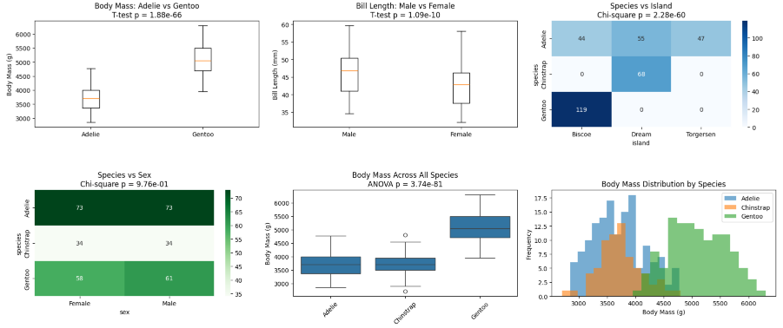
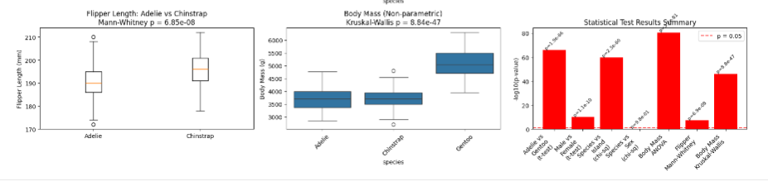
Summary

Slide 29
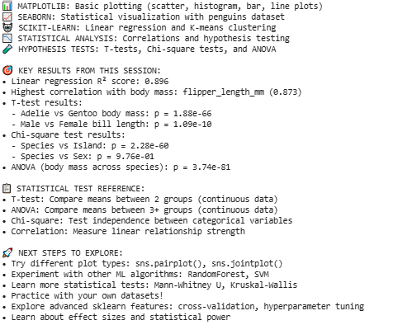
We covered:

Slide 30
HELPFUL RESOURCES:
• Matplotlib gallery: https://matplotlib.org/stable/gallery/
• Seaborn tutorial: https://seaborn.pydata.org/tutorial.html
• Scikit-learn user guide: https://scikit-learn.org/stable/user_guide.html
• SciPy stats documentation: https://docs.scipy.org/doc/scipy/reference/stats.html
• Statistical test selection guide: Choose the right test for your data type!

